Slide 1
Sentimental Gathering App
Ayush Jain
Galgotias College of Engineering and Technology,
Noida.

Slide 2
Problem Statement
As a part of research group that is working to find the interest levels of the students according to the time of the day and subject being taught, envision a mobile app which takes the sentiment of the class as a whole.

Slide 3
Problems
Sentiments differ every moment in lectures like some students might like the theory parts of the lecture, while others might like numerical parts of the lecture.
Nature of students First bench students have different behavior compare to the last bencher.
Can’t ask for user inputs.

Slide 4
What my app do ?
Detect the sentimental of the whole class by using facial emotion of every students in class for a sequence of images taken time to time.
The emotion from the face is converted into a color and then placed in the location where face was detected.
At the end we can view the emotions of all students sitting at different level throughout the lecture.

Slide 5
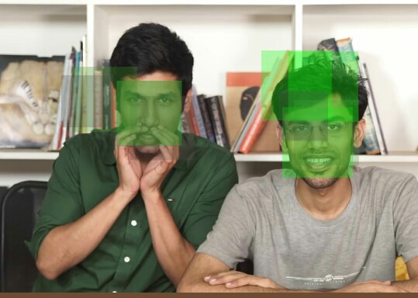

Slide 6
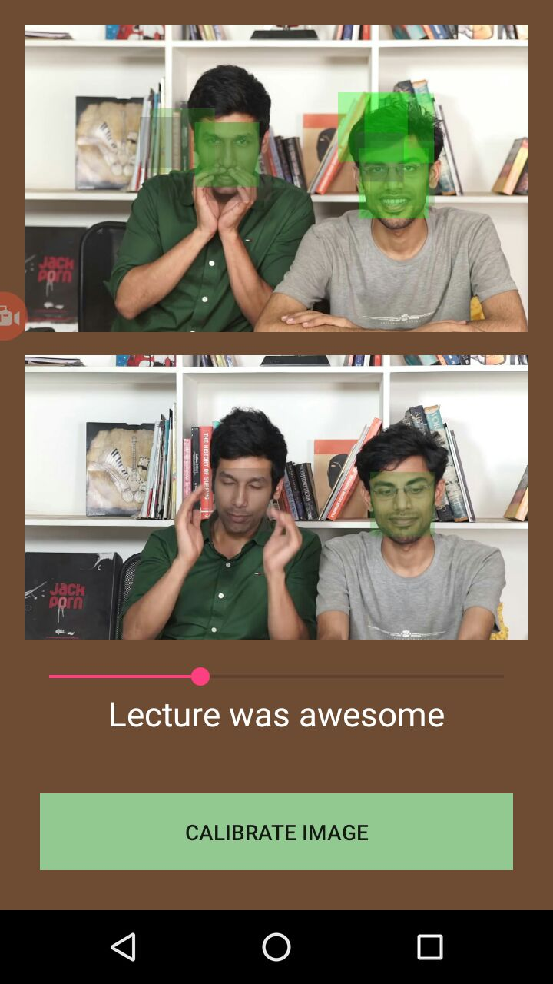
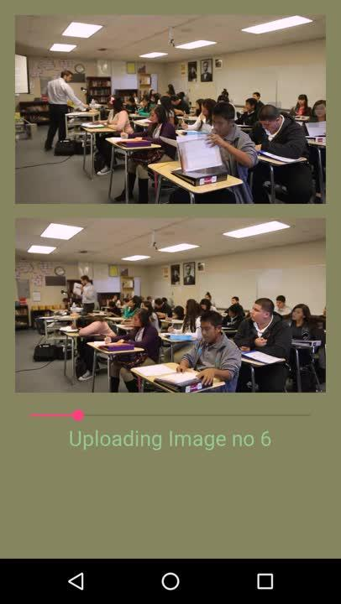
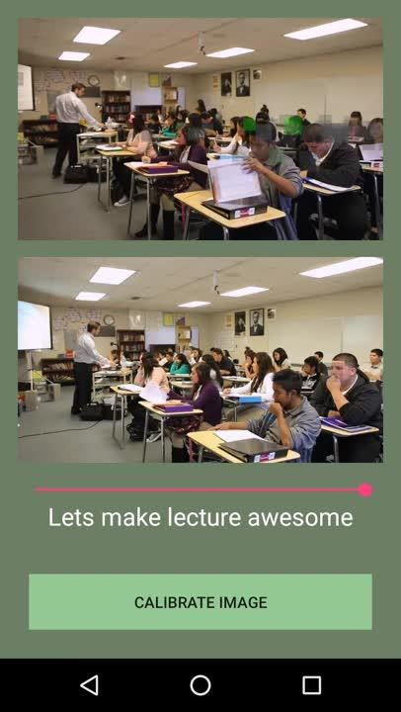

Slide 7
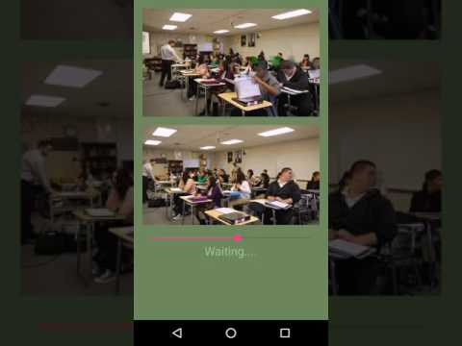

Slide 8
Advantage
Help to detect sentiment of a class as a whole as well as in individual level.
Analysis at what point students sentiments change.

Slide 9
Other Applications
In Shopping Complexes, to detect effect of discounts.
In Cinemas, to review movies on basis of its genre.
In Office, to analyse employee reactions.

Slide 10
THANK YOU

